Slide 1
WELCOME

Slide 2
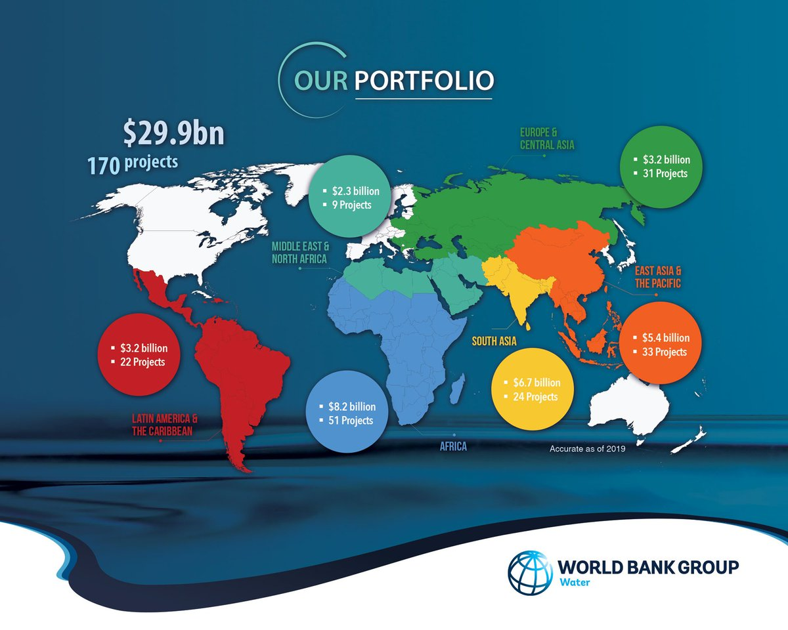
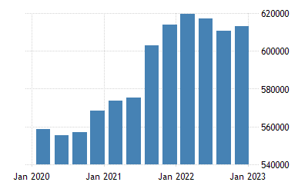
NAAN MUDHALVAN PROJECT
A COMPREHENSIVE ANALYSIS OF FINANCIAL PERFORMANCE :
INSIGHTS FROM A LEADING BANKS

Slide 3
TEAM LEADER : V.ARCHANA
TEAM MEMBERS :
R.Aishwarya
P.Annapooranam
S.Anusuya
We, a team of 4 students are from III B.Sc., Mathematics, A.K.D.Dharma Raja Women’s College , Rajapalayam.

Slide 4
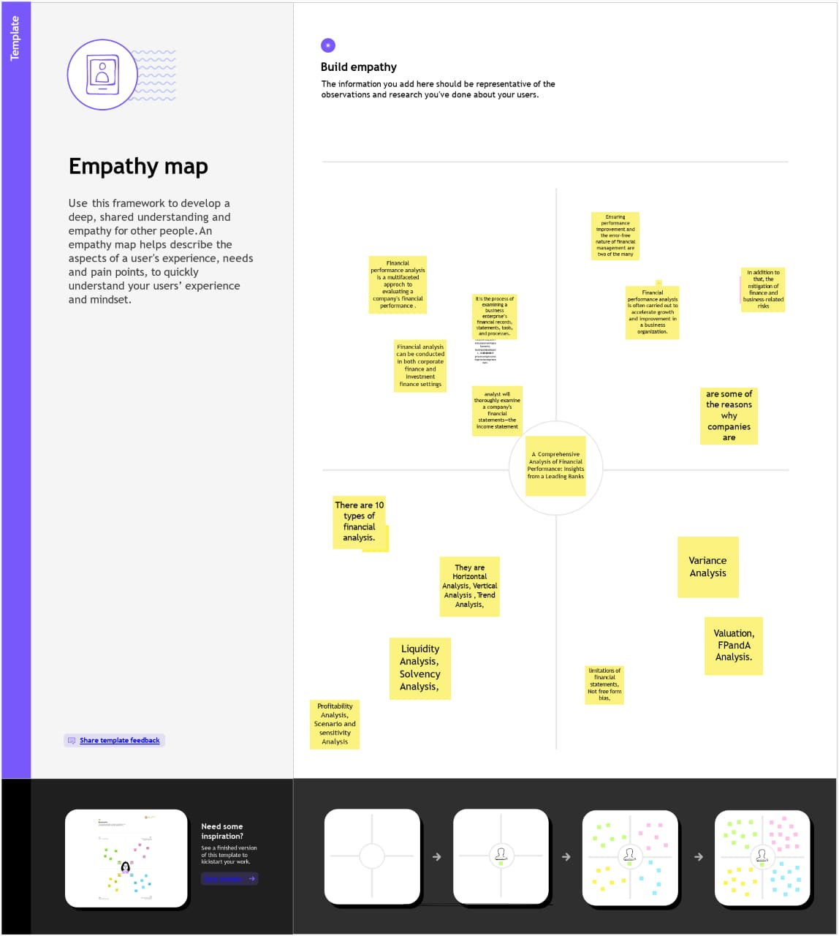
Empathy map:

Slide 5
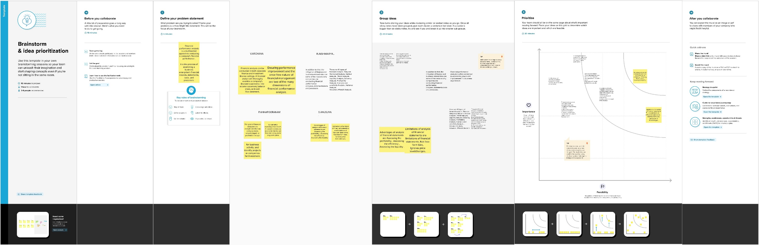
Brainstorming:

Slide 6
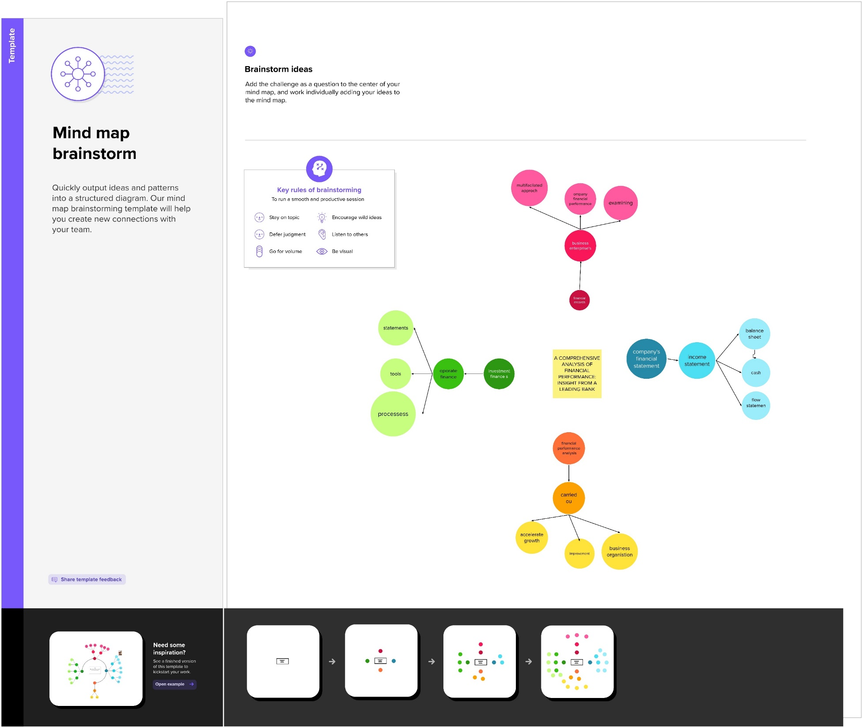
Mind map Brainstorm

Slide 7
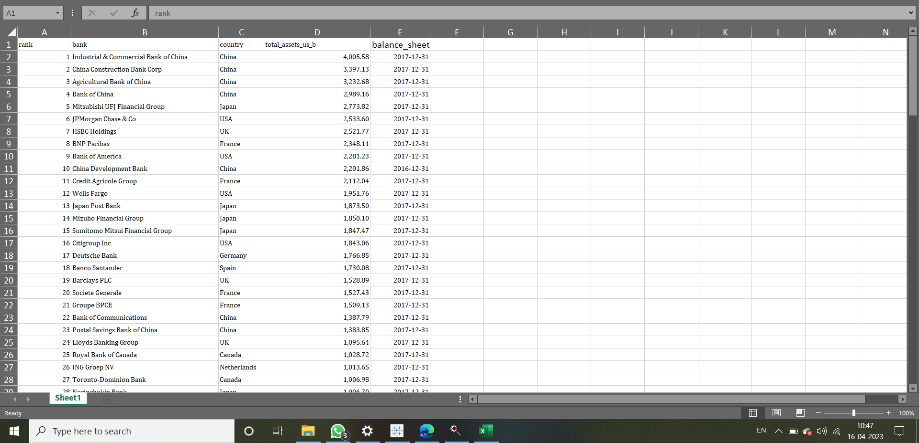
Analysing data

Slide 8


Slide 9
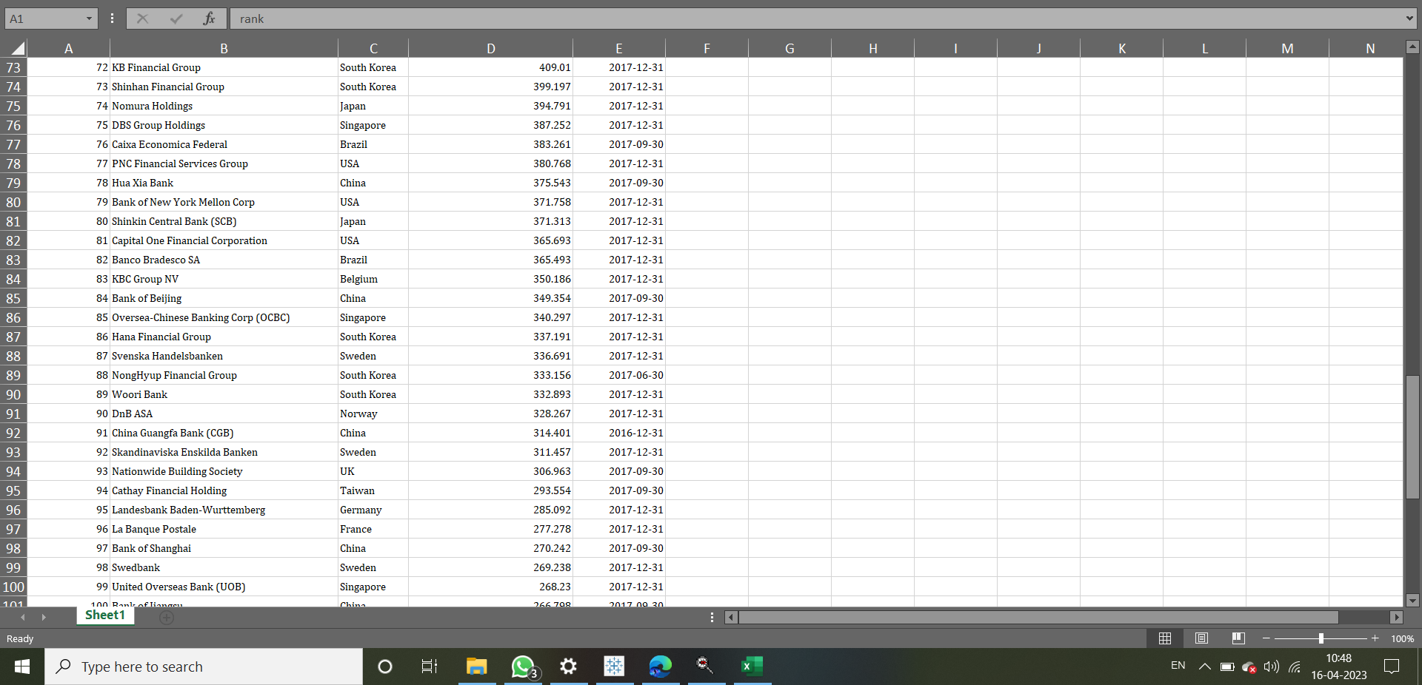

Slide 10


Slide 11
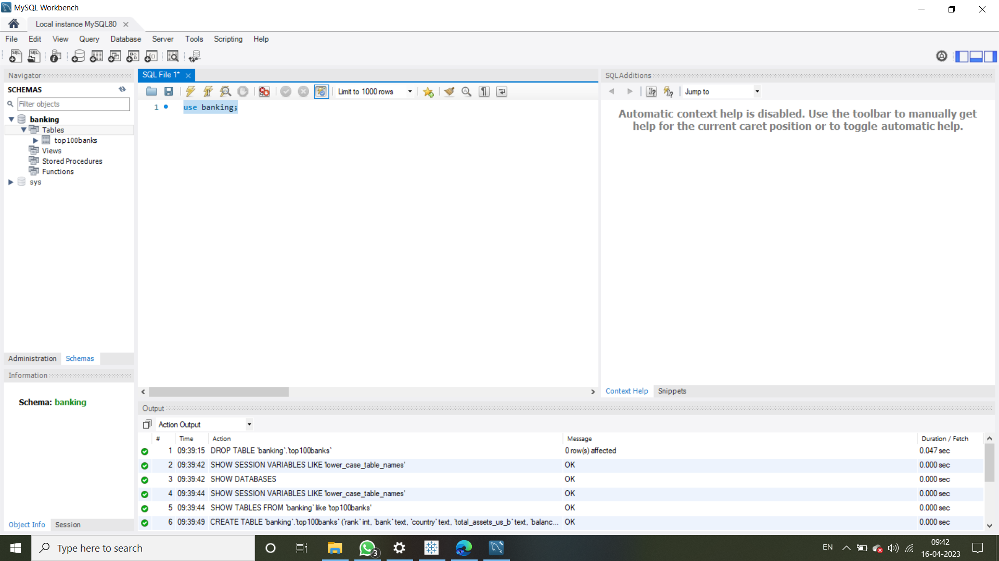
MySQL Workbench

Slide 12
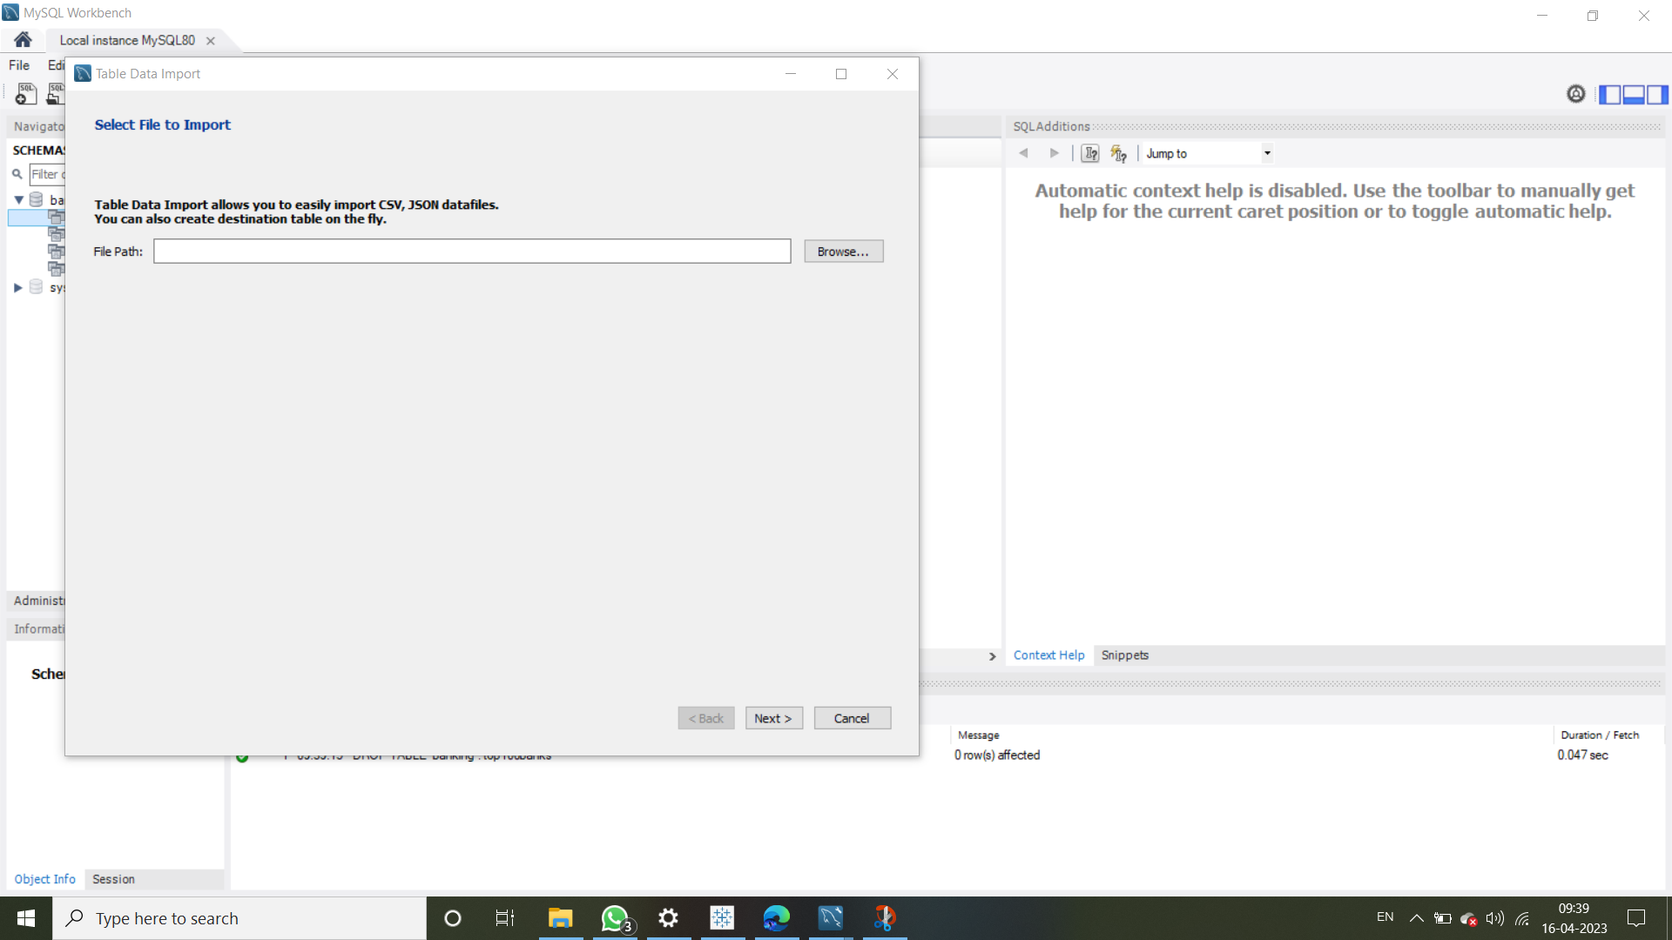

Slide 13
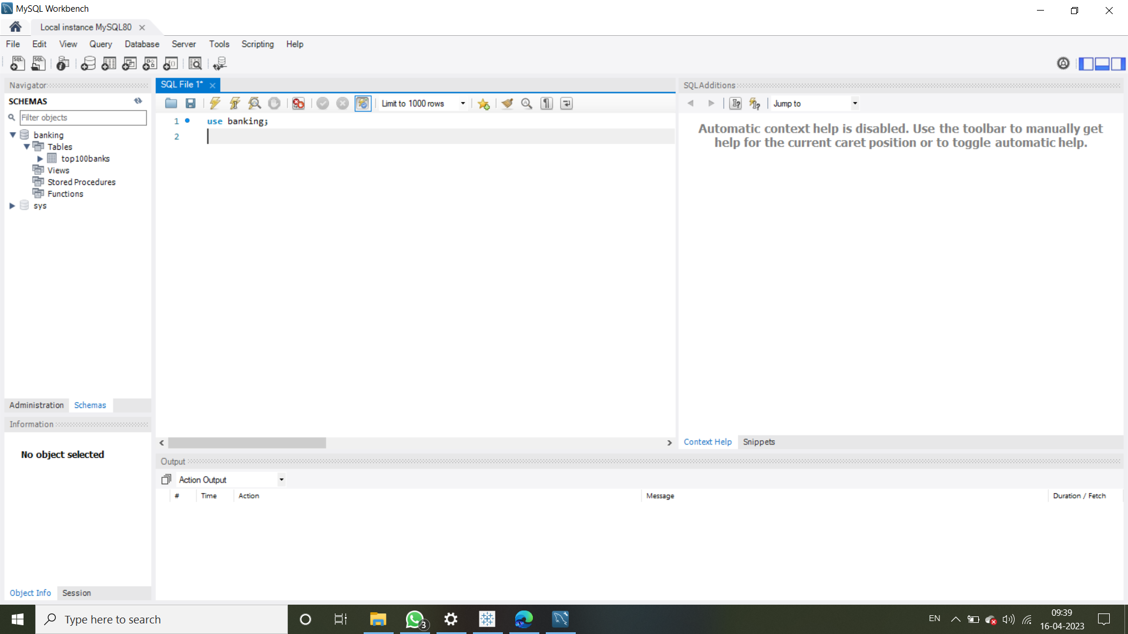

Slide 14
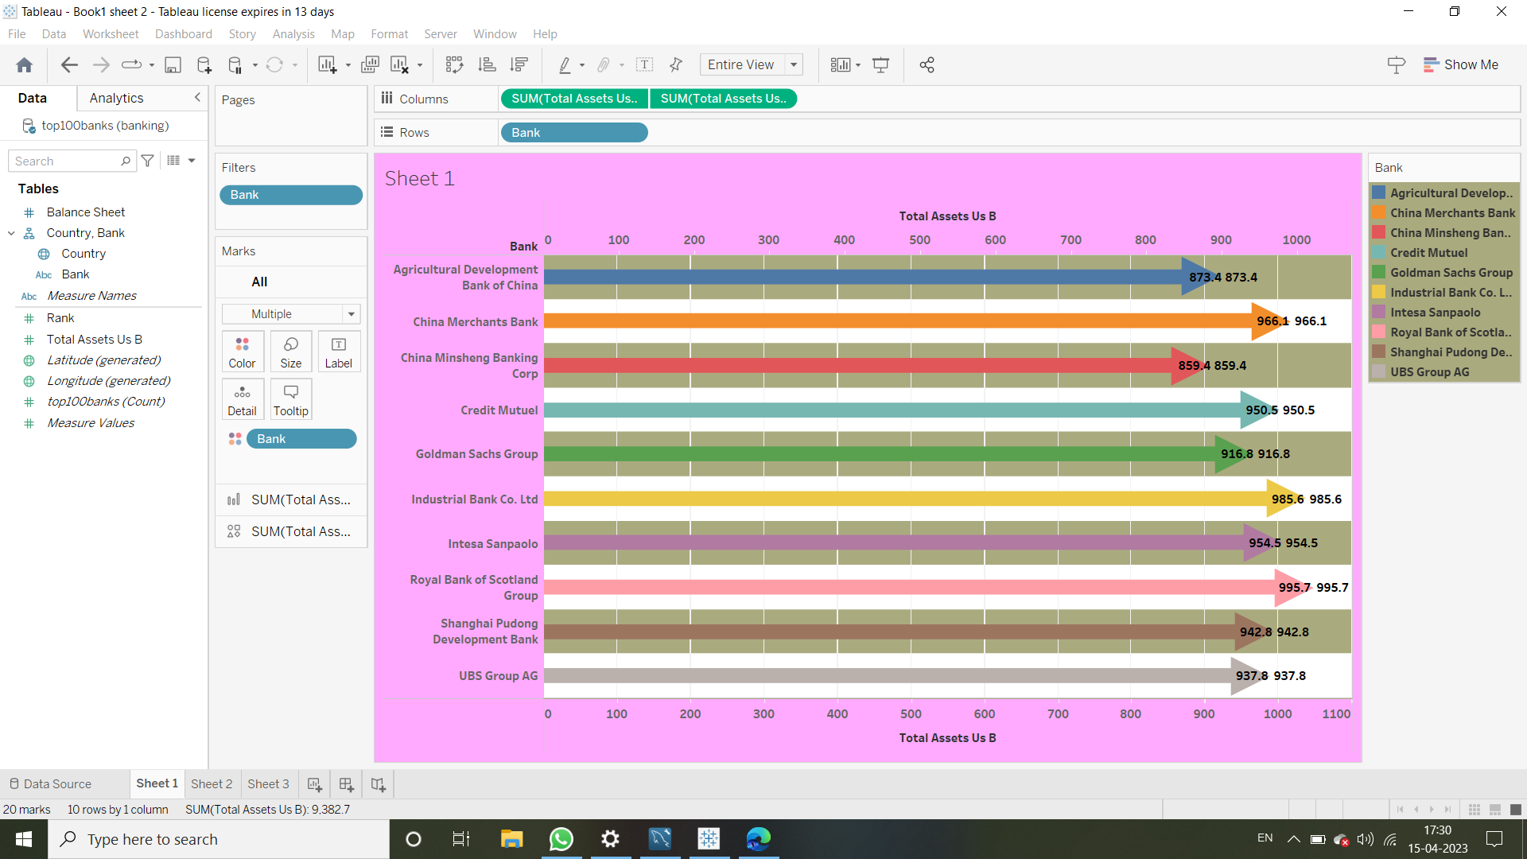
Total assets of banks based on country

Slide 15
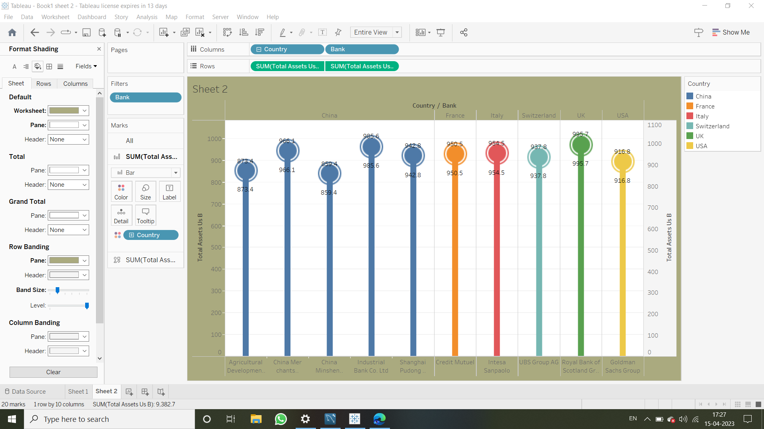
Top bank according to country based on total assets

Slide 16
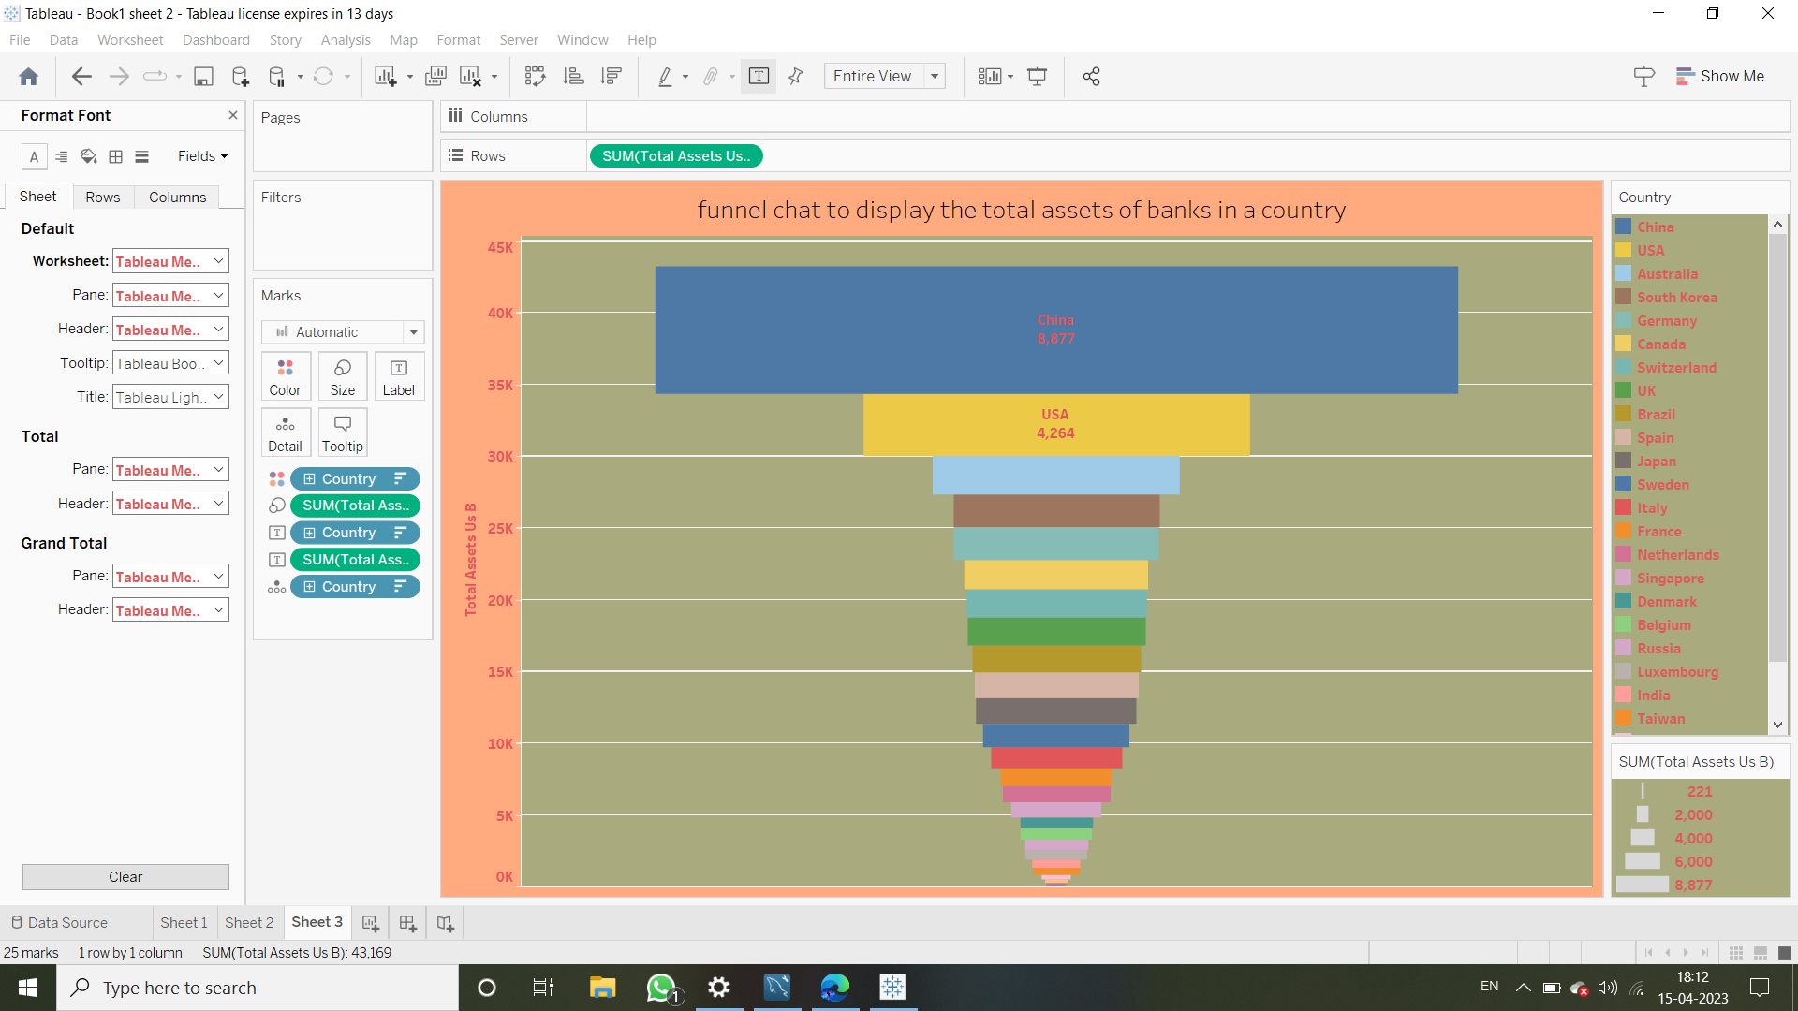
Funnel chat

Slide 17
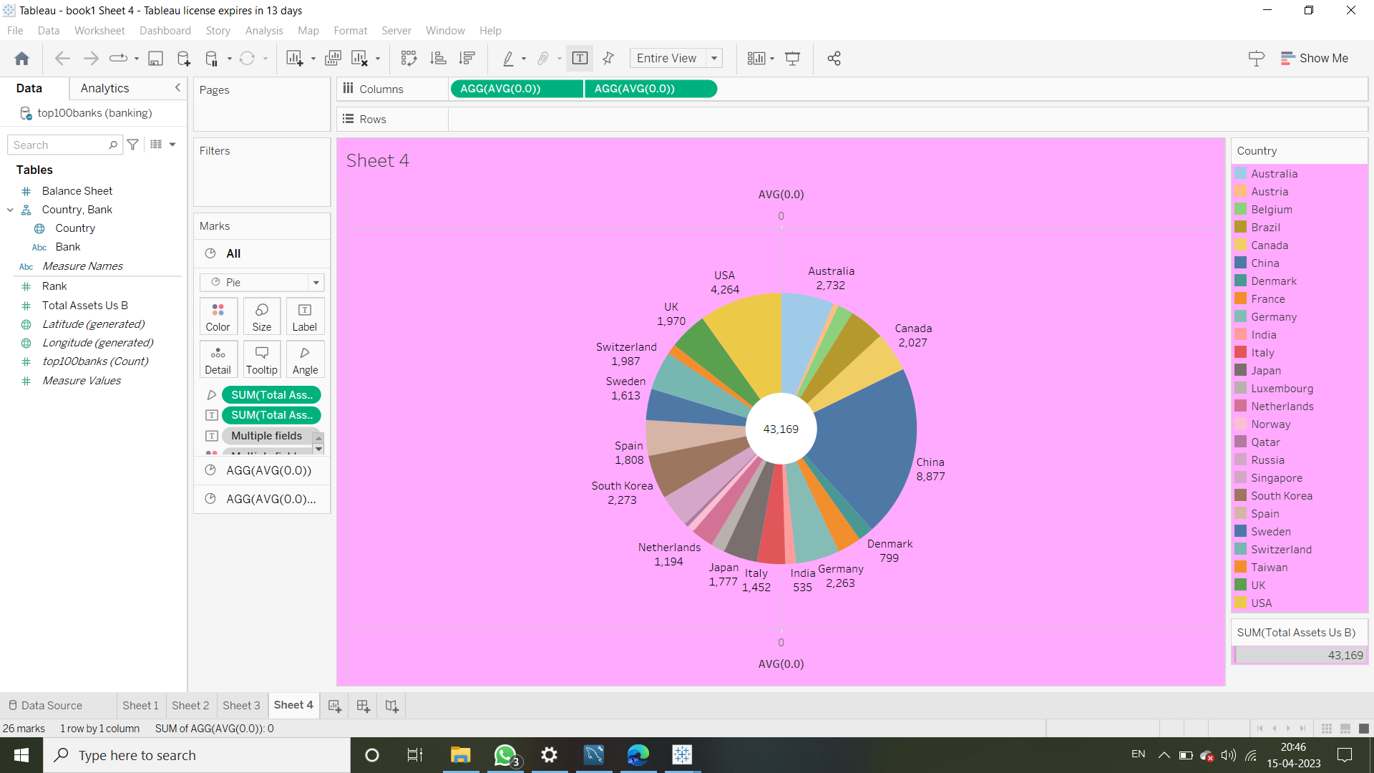
Top 10 countries with assets proportion

Slide 18
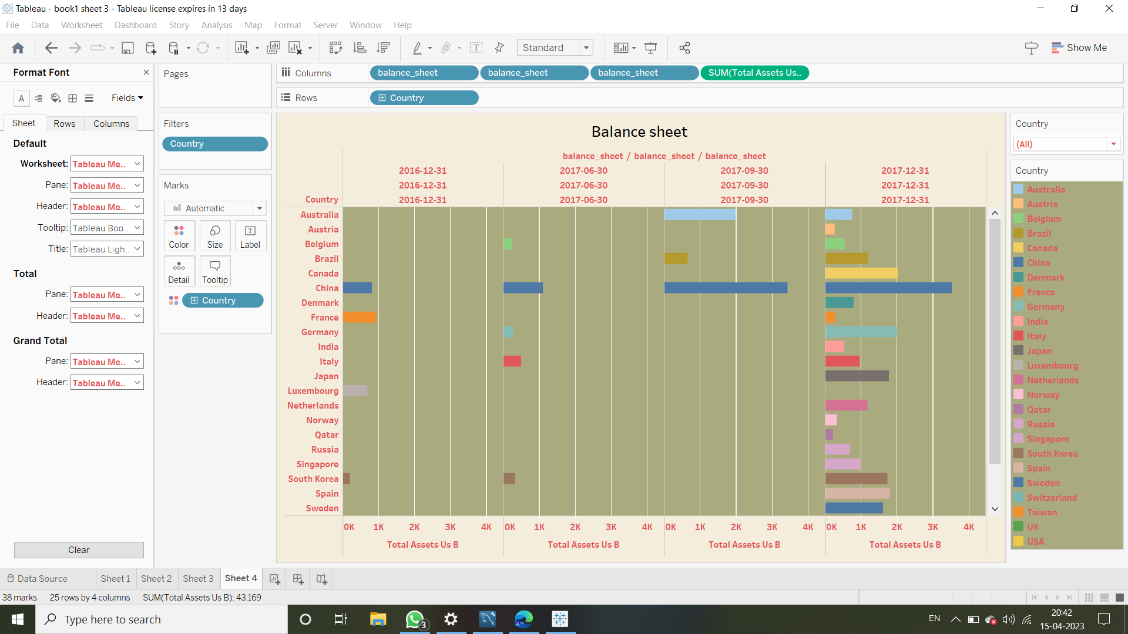
Total assets analysis according to year and quarter

Slide 19
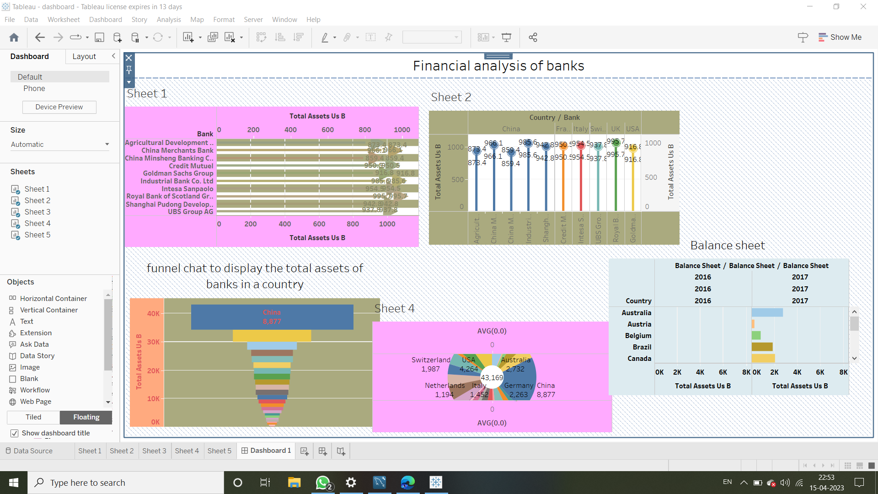
Financial analysis of banks

Slide 20
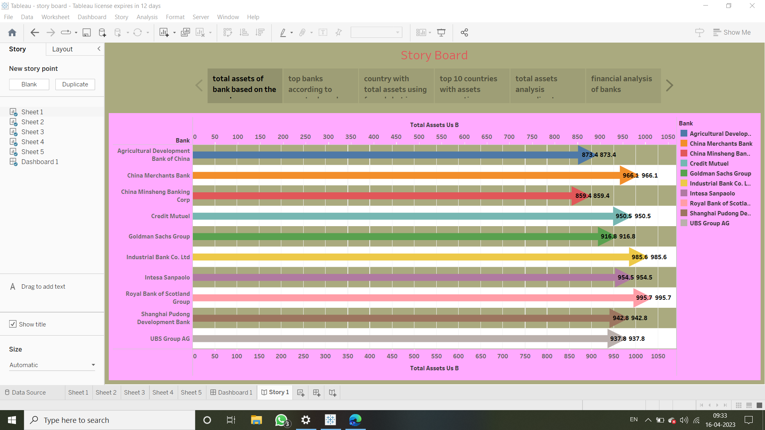
Story board:

Slide 21

Final Output:

Slide 22
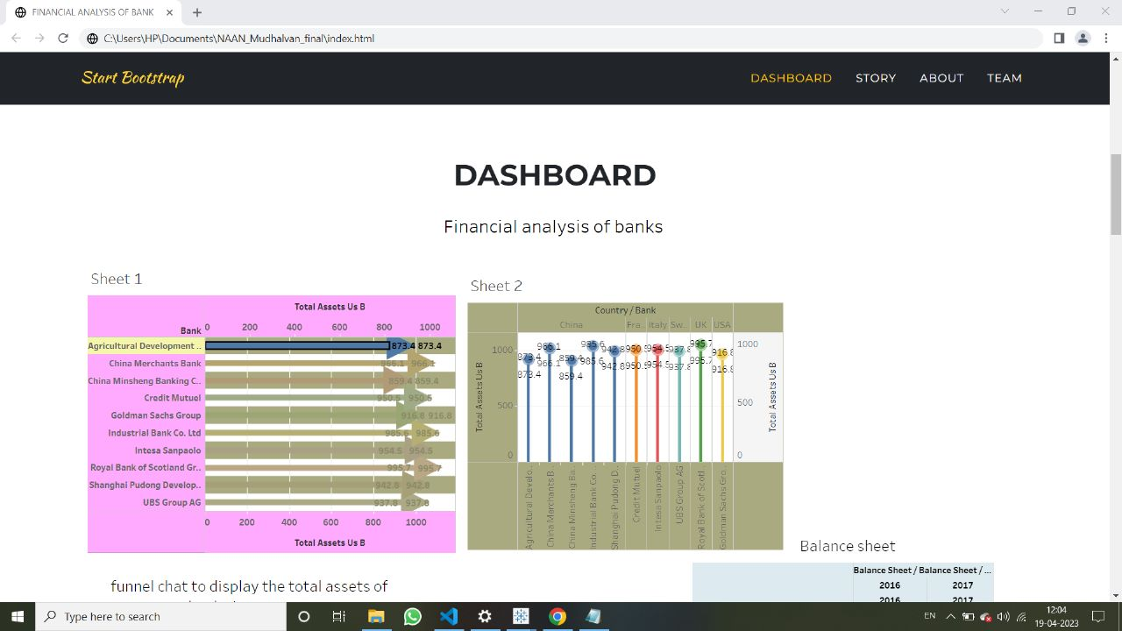
Dashboard:

Slide 23
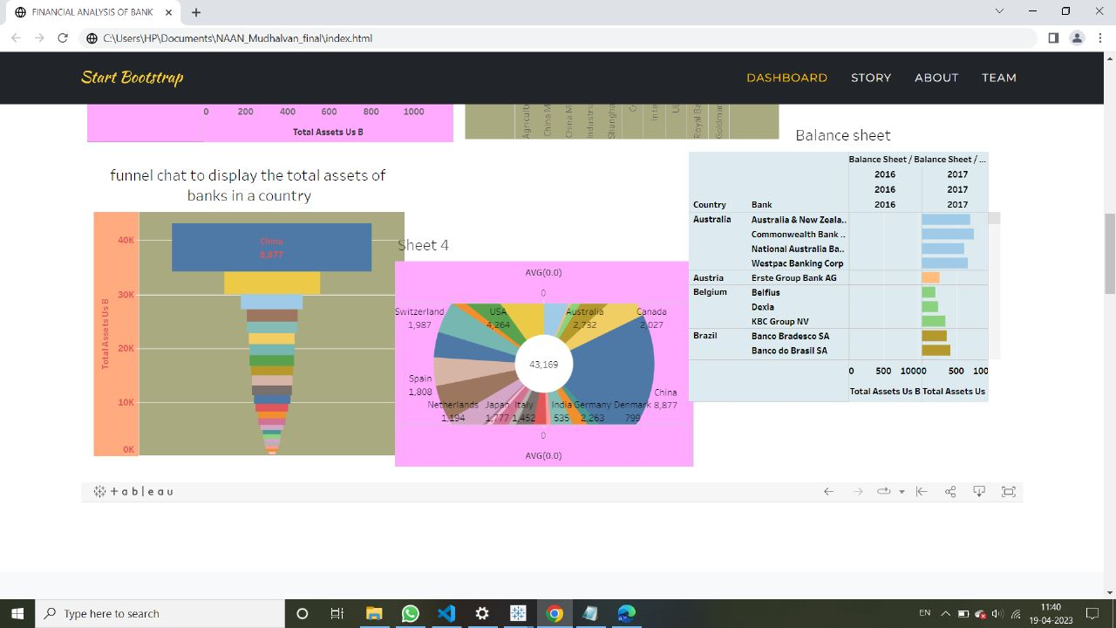

Slide 24
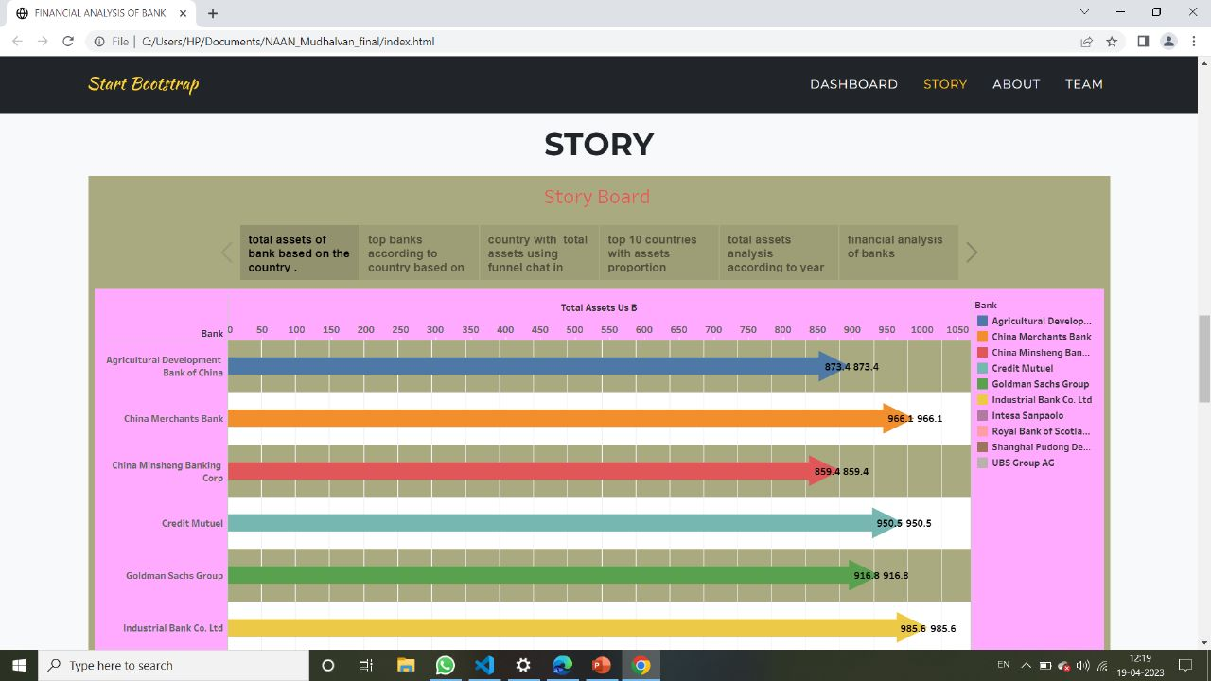
Story:

Slide 25
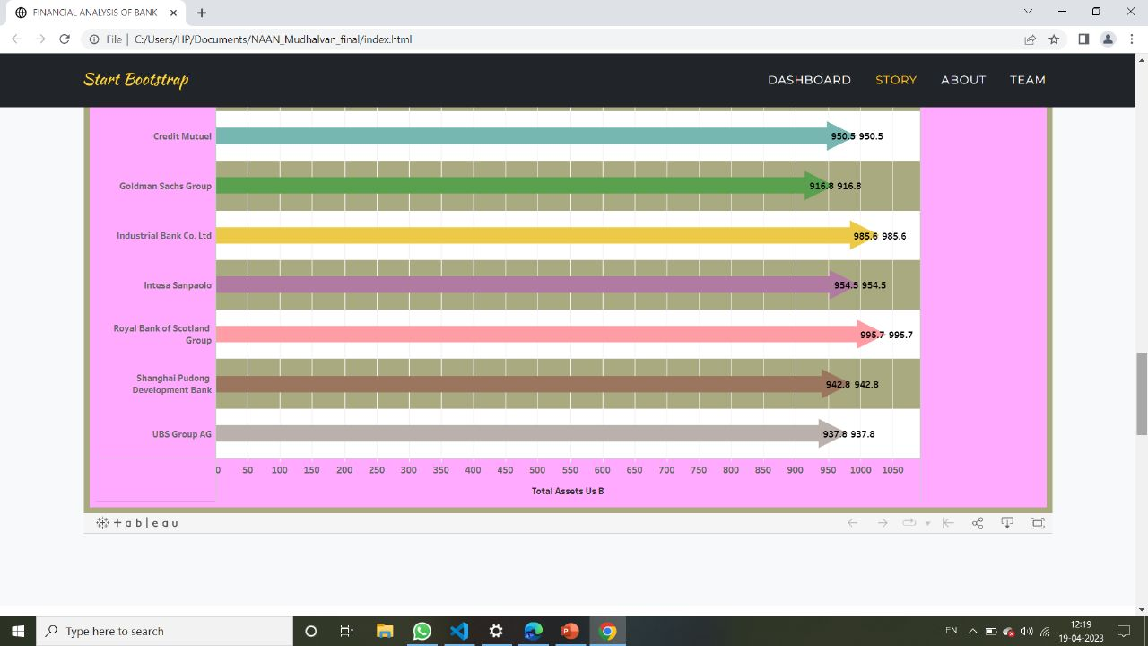

Slide 26
THANK YOU

